Slide 1
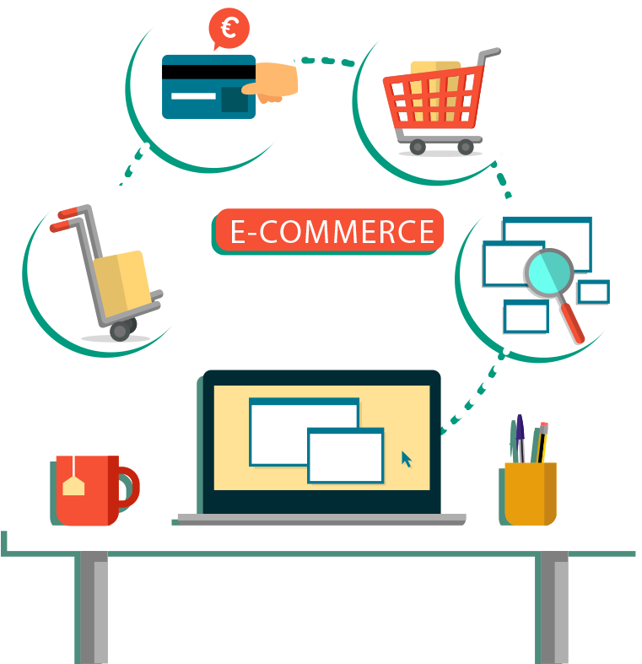
“ E-Commerce Web Application ” Task - 4
SUNSTONE

Slide 2

“ E-Commerce Web Application ”
An e-commerce website is one that allows people to buy and sell physical goods, services, and digital products over the internet rather than at a brick-and-mortar location. Through an e-commerce website, a business can process orders, accept payments, manage shipping and logistics, and provide customer service.

Slide 3
Task 4 :: Dynamic Frontend
Integrate the APIs to frontend to ensure the dynamic feature of website
Point base api to the severs base url
Design api calls for each element
Handle errors in the output
Render output of apis to different low level components
Secure content of post apis
Evaluation Metric:
100% Completion of the above tasks
Learning outcome
Developing complicated UI using HTML components
Using props drilling and context to pass variables
Getting familiar with different type of api calls
Handling different input data

Slide 4
Step-Wise Description
Website Design and Layout:
Create wireframes and mockups to plan the website's layout.
Design a user-friendly, responsive, and visually appealing website.
Consider the user experience (UX) and user interface (UI) design.
Select an E-Commerce Platform:
Choose an e-commerce platform like Shopify, WooCommerce (for WordPress), Magento, or others, depending on your business needs and budget.
Content Creation:
Write product descriptions, create high-quality images, and gather other content for your website.
Develop a content strategy that includes blog posts, FAQs, and other informative materials.
Website Development:
Develop the website using HTML, CSS, and JavaScript or use a content management system (CMS) with e-commerce capabilities.
Add necessary features such as product catalogs, shopping carts, and payment gateways.
Payment Gateway Integration:
Choose and integrate a secure payment gateway like PayPal, Stripe, or Square to facilitate online payments.
Security Setup:
Implement SSL (Secure Sockets Layer) to secure data transmission.
Regularly update your website and plugins to protect against security vulnerabilities.
Product Management:
Organize and categorize your products or services.
Set up inventory management and track stock levels.
Shopping Cart and Checkout:
Create a seamless shopping cart experience with clear calls to action (CTAs).
Optimize the checkout process to reduce cart abandonment rates.
Summary of your task
Website Design: Create a user-friendly, responsive, and visually appealing design.
Select E-Commerce Platform: Choose a suitable e-commerce platform.
Content Creation: Develop product descriptions, images, and content strategy.
Website Development: Build the website with necessary features.
Payment Gateway Integration: Integrate secure payment gateways.
Security Setup: Implement SSL and maintain security.
Product Management: Organize and manage products or services.
Shopping Cart and Checkout: Optimize the cart and checkout process.

Slide 5
Assessment Parameter
Design Schema for data to be stored
Point all routes with a appropriate controllers to control request and response
Set mongodb server on localhost
Check-List
Add authentication middleware to all protected routes
Add dummy data with schema in mongodb server
Filter and santize all the incoming data in http requests
Run some test queries to test the server
Set up secure environment variables for secret keys

Slide 6
Submission Github
https://github.com/sakthivel3031/NM-AIT-GROUP8

